Slide 1
Thorndike’s Theory of Learning

Slide 2
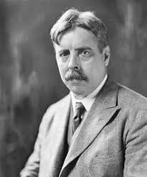
Thorndike’s Theory of Learning
Edward Lee Thorndike (1874- 1949).
Pioneering American psychologist whose work laid the groundwork for modern theories of learning and behaviour.
Theory- Emerged in early 20th century.

Slide 3

Learning is the result of association between stimulus and response (S-R bond)
With the help of experiments, he tried to evolve certain laws
  Theory of Connectionism (Trial and Error).

Slide 4
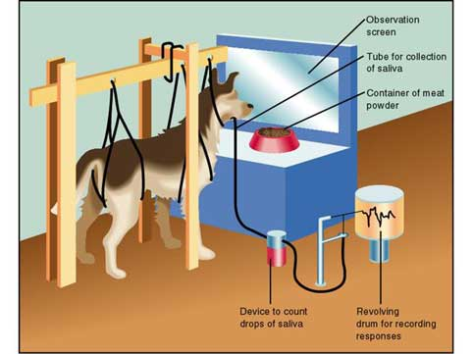
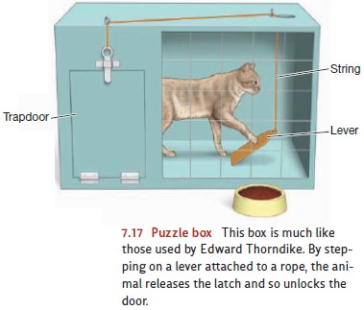
Pavlov
Thorndike

Slide 5
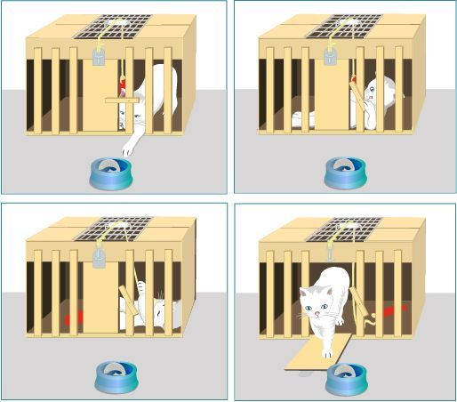
Thorndike’s Experiment
Placed cat in a locked wooden box- ‘puzzle box’.
Pressing the lever
Door opens
Cat escape & reach a food reward
Video

Slide 6
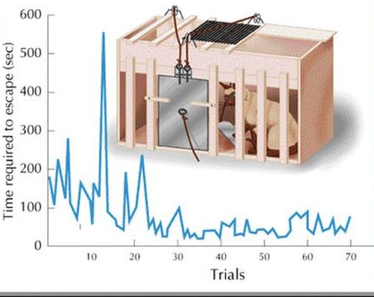
Thorndike' Observations:
The time cat took each time to reach food decreased as the cat associated the lever with the food.
~ This helped him develop the Law of Effect.
A well practiced cat quickly recalls the actions
that helps escape the box to its reward.
If the response to stimuli produced a satisfying effect - they are likely to be repeated
If the response to stimuli produced an unsatisfying effect - they are likely to be avoided

Slide 7
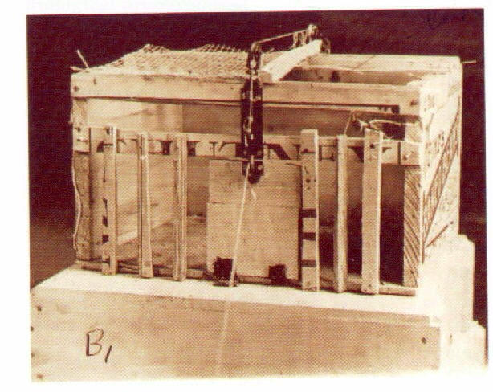
Later, Thorndike modified the theory to add an element called the Law of Exercise
Initially he believed that frequent connections of stimulus & response strengthens that connection
But, as he continued his work he realized that it is not necessarily true.
If the response leads to an unsatisfying effect or punishment, the connection between the stimulus and response will not be strengthened.

Slide 8

Being subject to continuous pulling of lever and escaping boxes- cat was observed to ignore the lever and leave the response hanging
This idea fits into Law of Readiness
The relationship between the stimulus and
response is based on subject’s readiness to
learn.

Slide 9
